Slide 1
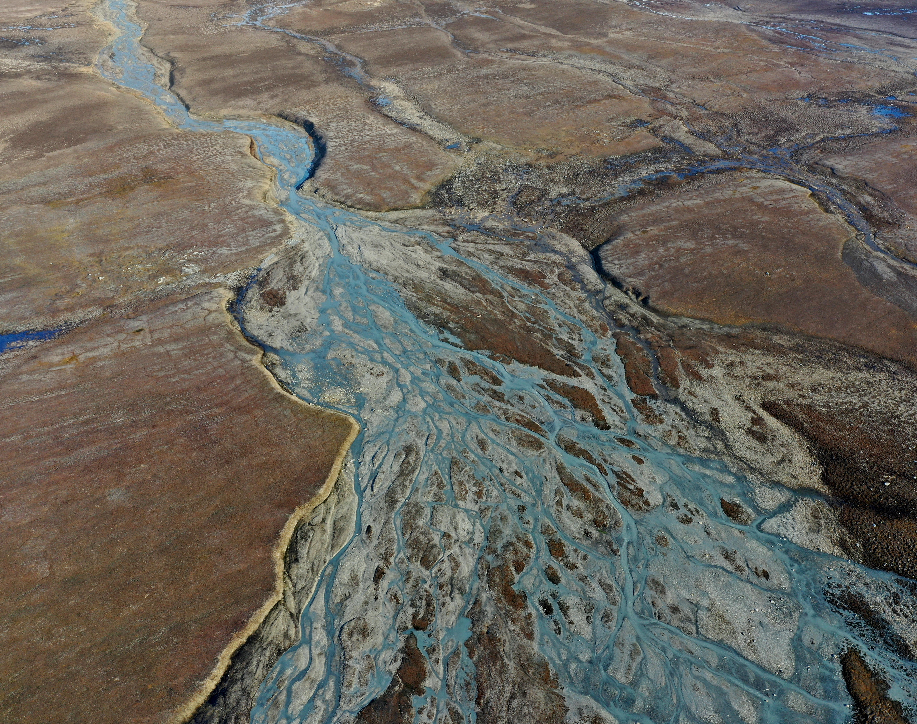


ICARP IV
The Fourth International Conference for Arctic Research Planning (ICARP IV) Process 2022 - 2026
Photo: Ireneusz Sobota

Slide 2
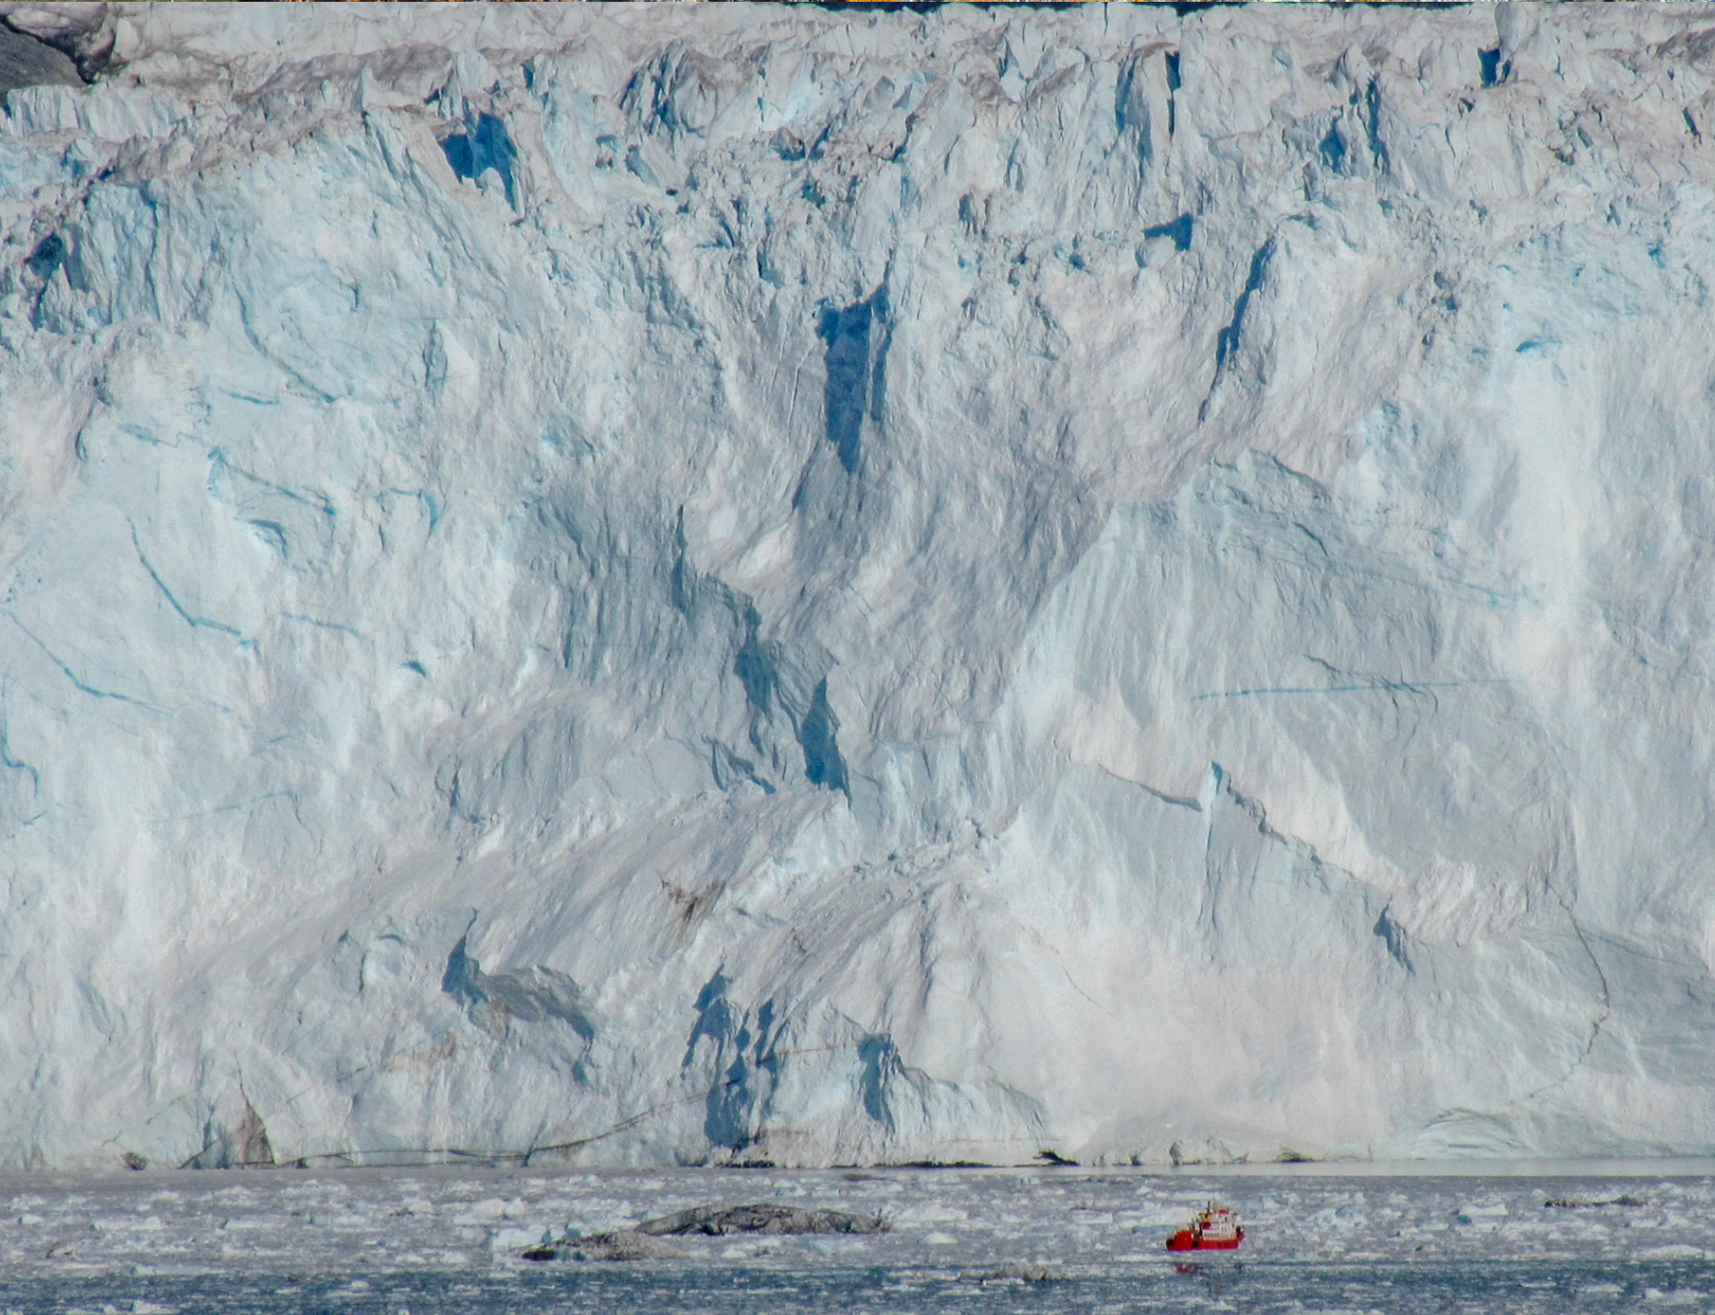
ICARPs – 30 years of Arctic Research Planning
1995
ICARP I - Hanover NH (USA)
2005
ICARP II - Copenhagen (Denmark)
2015
ICARP III - Toyama (Japan)
2025
ICARP IV – Boulder CO (USA)
ICARP = International Conference on Arctic Research Planning Process
Decadal international Arctic research planning process organised by the International Arctic Science Committee (IASC) in cooperation with international partners every 10 years since 1995.
Photo: Isak Erik Lybert

Slide 3
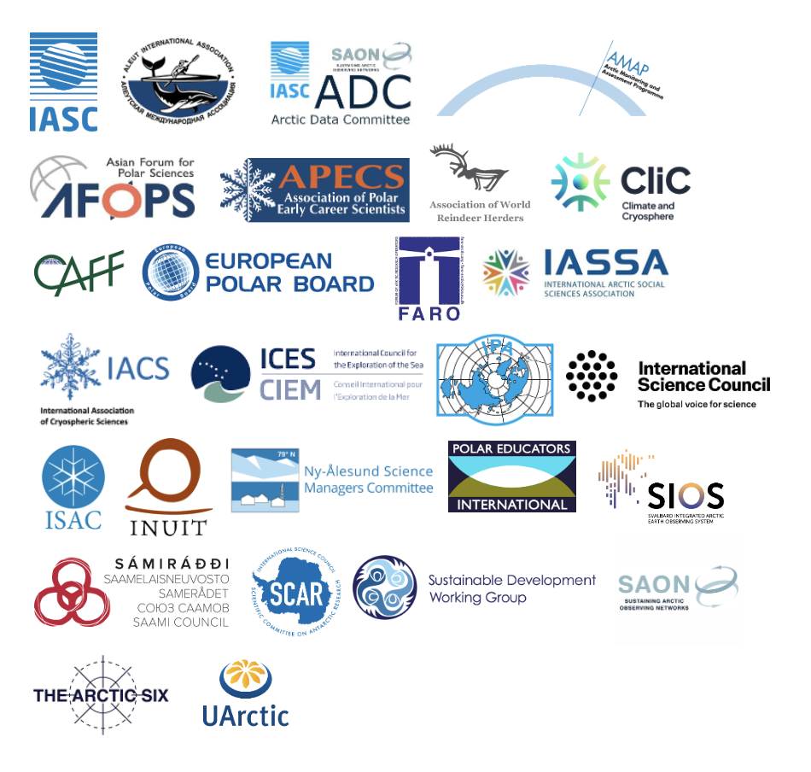
ICARP IV
2025 – Boulder, Colorado, USA
Coordinated by International Arctic Science Committee (IASC) in cooperation with 26 international organisations
Community-wide undertaking from 2022 to 2026 that engages Arctic researchers, Indigenous Peoples, policy makers, residents and stakeholders from around the world to:
consider the most urgent needs and priorities for Arctic research for the next decade until 2035
Develop recommendations to implement these priorities

Slide 4
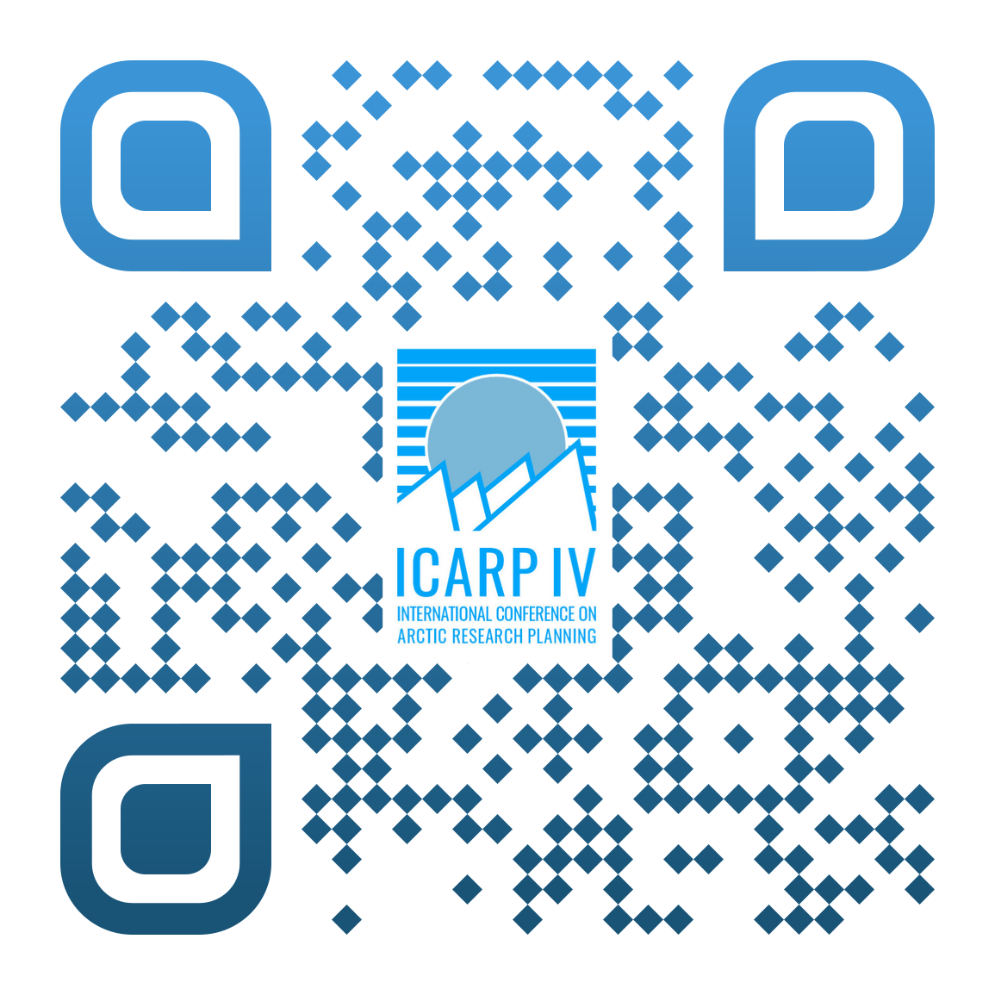

Fourth International Conference on Arctic Research Planning Process (ICARP IV) 2022 – 2026: Overview
ICARP IV Community Engagement Activities throughout 2023 / 2024
(e.g. Workshops, Information Sessions, Survey, Webinars )
Phase 2
Presentation of draft results from the RPTs during ICARP IV Summit
Consultation on draft outcomes
RPT Reports available (October 2025)
Phase 4
Preparing for
ICARP IV
Defining Research Priorities
Initiating Implementation
www.ipy5.info
and earlier programmes and initiatives!
Contribution to Arctic research planning for the
Seeking Community Input
Consulting on Priorities
Phase 1
ICARP IV International Steering Committee formed
ICARP IV Summit Host Committees formed
www.icarp.iasc.info
Phase 3
ICARP IV Research Priority Teams (RPTs) formed
ICARP IV Indigenous Peoples´Coordination Group formed
RPT Kick-off Workshops
ASSW 2024, Edinburgh, Scotland, UK, 21 – 29 March 2024
ICARP IV Planning Retreat
21 - 23 October 2024,
Akureyri, Iceland
Phase 5
ICARP IV final outcomes
presented at
ASSW 2026
25 March – 1 April 2026, Aarhus, Denmark
ICARP IV Summit within ASSW 2025
20 – 28 March 2025,
Boulder, Colorado, USA
2026
2025
2024
2023
2022
2027 - 33

Slide 5
Fourth International Conference on Arctic Research Planning Process (ICARP IV) 2022 – 2026: Overview
Defining Research Priorities
Consulting on Priorities
Phase 3
ICARP IV Research Priority Teams (RPTs) formed
ICARP IV Indigenous Peoples´Coordination Group formed
RPT Kick-off Workshops
ASSW 2024, Edinburgh, Scotland, UK, 21 – 29 March 2024
ICARP IV Planning Retreat
21 - 23 October 2024,
Akureyri, Iceland
Phase 4
ICARP IV Summit within ASSW 2025
20 – 28 March 2025,
Boulder, Colorado, USA
Presentation of draft results from the RPTs during ICARP IV Summit and consultation on draft outcomes
RPT Reports available (October 2025)
Contribution to Arctic research planning for the
2024
2025

Slide 6
ICARP IV Research Priority Teams - Definining Research Priorities 2024 - 2025
7 Teams
209 members in total
28 countries
Team 1: The Role of the Arctic in the Global System
Team 2: Observing, Reconstructing, and Predicting Future Climate Dynamics and Ecosystem Responses
Team 3: Understanding the dynamics and resilience of Arctic social-ecological systems to foster sustainable futures
Team 4: Arctic Research Cooperation and Diplomacy
Team 5: Co-Production and Indigenous-led methodologies
Team 6: Education and knowledge-sharing in and about the Arctic: Research and Practice
Team 7: Technology, Infrastructure, Logistics, and Services
2022
2024
2025
2026
2023
Notes:
Earlier this year we have created 7 Research Priotity Teams for the themes listed here. Team 1 – 3 were based on the outcomes of the last ICARP III process in 2015. The remaining teams were added as other significant topics that needed to be address within the current process.
More than 200 people (researchers of all career stages, Indigenous scholars and others) from 27 countries are currently engaged in the RPTs.

Slide 7
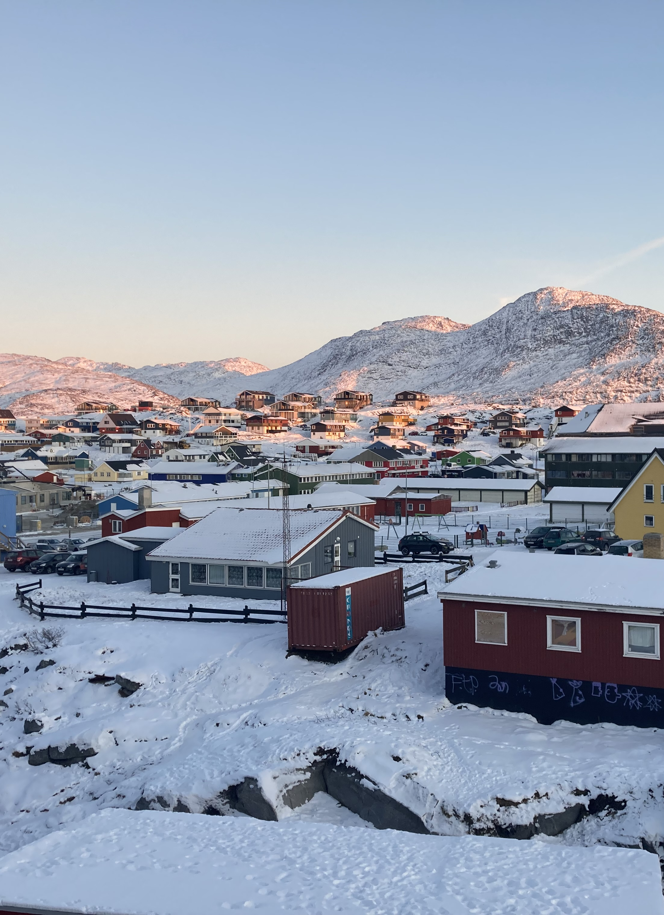
ICARP IV Research Priority Teams - Tasks
Review and analyse Community Input
Define the needs and priorities for Arctic research research for the next decade for their topic area based on the input collected
Recommendations for the implementation of the identified priorities (incl. potential new alliances and collaborative partnerships needed to address them).
Photo: Federica Scarpa
2022
2024
2025
2026
2023
Notes:
The teams are tasked to:
Review and analyse the community input that was provided during the engagement phase
Define knowledge gaps and research priorities for their topic areas (always with a 10-year outlook).
Develop recommendations for the implementation of the identified research priorities (including but not limited to potential new alliances and collaborative partnerships needed to address them especially with a focus on the upcoming International Polar Year)

Slide 8

ICARP IV Research Priority Teams (RPTs) –Timeline
Mar. 2024
RPT Kick-off Workshops during ASSW 2024
Oct. 2024
ICARP IV Planning Retreat in Akureyri, Iceland from 21 – 24 October 2024
Mar. 2025
ICARP IV Summit / ASSW 2025 in Boulder, Colorado, USA from 20 – 28 March 2025
Presentation of the draft RPT results for consultation!
Nov. 2025
ICARP IV RPT final results reported
March 2026
ICARP IV Final Results published
www.ipy5.info
and earlier programmes and initiatives!
Contribution to Arctic research planning for the
Notes:
The RPTs have started their work in March during our Arctic Science Summit Week 2024 in Edinburgh
And they will present their draft results / outcomes for further public consultation next year during the ICARP IV Summit 2025 / ASSW 2025.

Slide 9
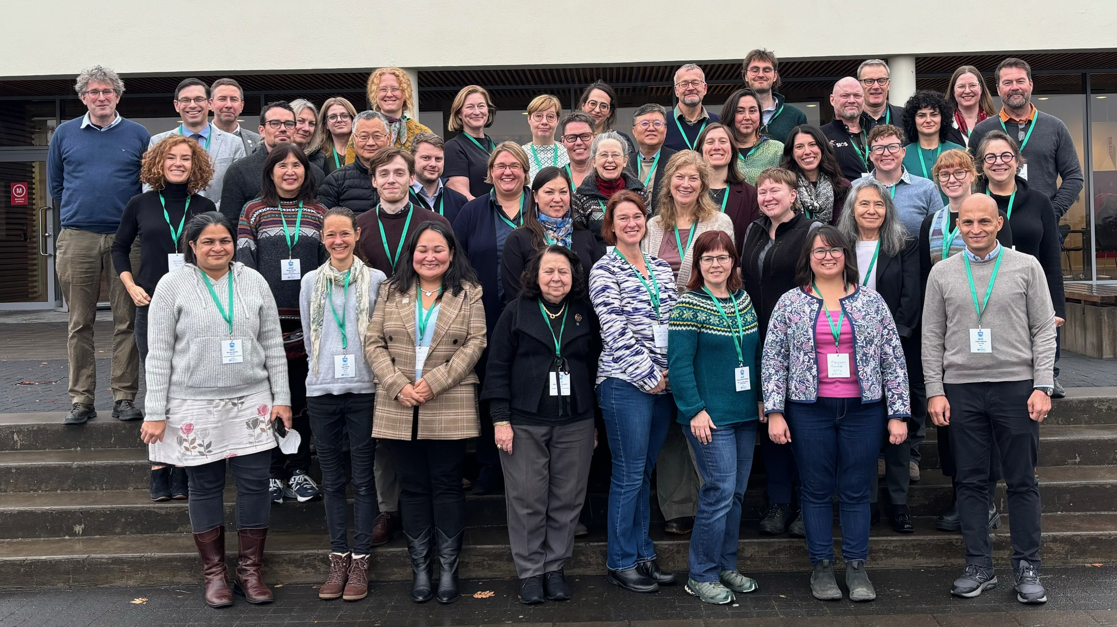
Oct. 2024
ICARP IV Planning Retreat in Akureyri, Iceland from 21 – 24 October 2024
Workshop for:
RPT Chairs
International Steering Committee
Icelandic partners
→50 participants from 13 countries
Photo: Federica Scarpa
2022
2024
2025
2026
2023
Notes:
The teams are tasked to:
Review and analyse the community input that was provided during the engagement phase
Define knowledge gaps and research priorities for their topic areas (always with a 10-year outlook).
Develop recommendations for the implementation of the identified research priorities (including but not limited to potential new alliances and collaborative partnerships needed to address them especially with a focus on the upcoming International Polar Year)

Slide 10
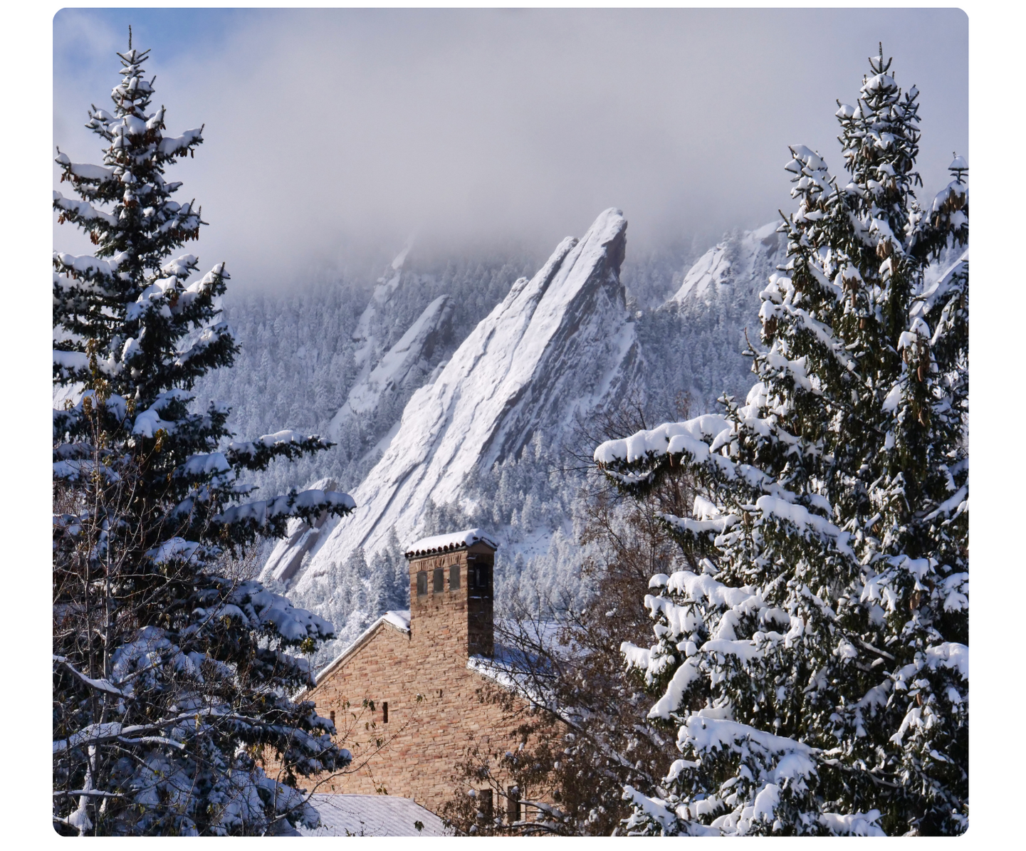
Mar. 2025
ICARP IV Summit / ASSW 2025 in Boulder, Colorado, USA from 20 – 28 March 2025
Presentation of the draft RPT results for consultation!
ASSW 2025 incl. ICARP IV Summit
20-28 March 2025 in Boulder, Colorado, USA including:
  20 - 24 March 2025: ASSW 2025 Business and Community Meetings
  25 – 28 March 2025: ICARP IV Summit
Registration open with early bird registration deadline on 31 January 2025.
More information: www.assw.info
Courtesy of University of Colorado Boulder

Slide 11
Nov. 2025
ICARP IV Research Priority Team Reports available
RPT Reports will include:
Definition of the Focus of the RPT and list of the RPT members
Explanation of the principles, approaches and methods used in the RPT work
Priorities and needs in Arctic research for the next decade
  Needs and priorities specific to the RPT topic area
  Cross-cutting needs and priorities
Recommendations to implement the identified priorities for Arctic research
  Implementation of the RPT-specific priorities
  Implementation of the cross-cutting priorities
Recommendation on tracking the implementation of the outcomes
Photo: Federica Scarpa
2022
2024
2025
2026
2023
Notes:
The teams are tasked to:
Review and analyse the community input that was provided during the engagement phase
Define knowledge gaps and research priorities for their topic areas (always with a 10-year outlook).
Develop recommendations for the implementation of the identified research priorities (including but not limited to potential new alliances and collaborative partnerships needed to address them especially with a focus on the upcoming International Polar Year)

Slide 12

ICARP IV Reporting and Implementation
Initiating Implementation
Contribution to Arctic research planning for the
www.ipy5.info
and earlier programmes and initiatives!
Phase 5
ICARP IV final outcomes
presented at
ASSW 2026
25 March – 1 April 2026, Aarhus, Denmark
Contribution to Arctic research planning for the
2026
2027 - 2033

Slide 13
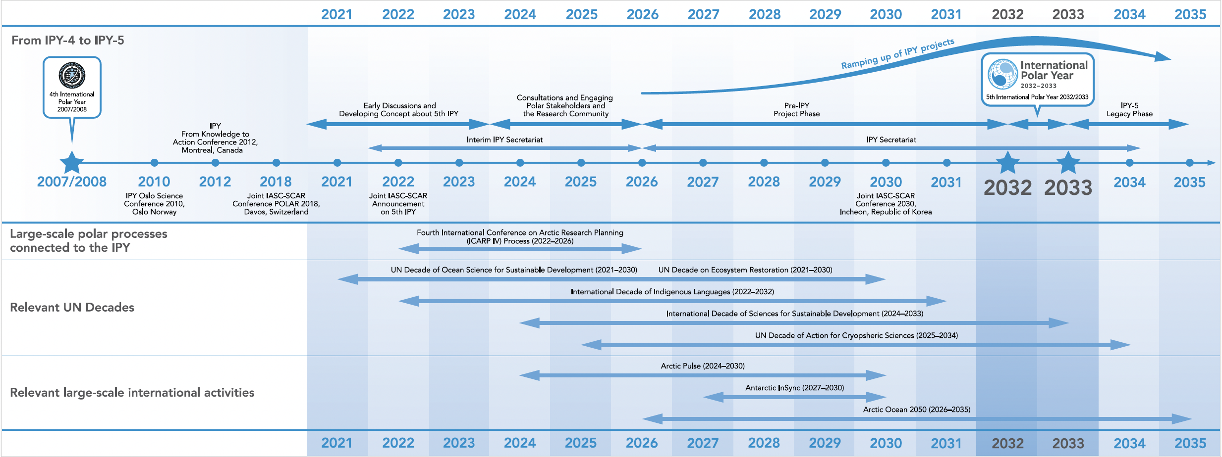
IPY-5 Planning Timeline

Slide 14
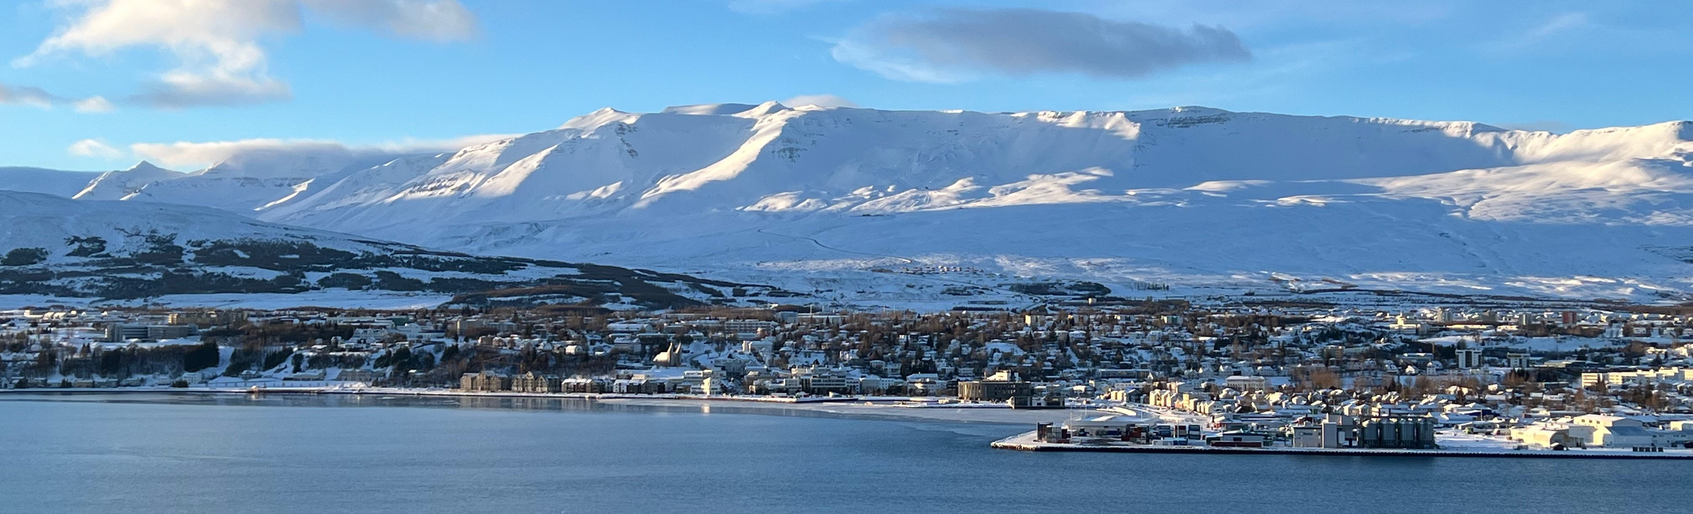
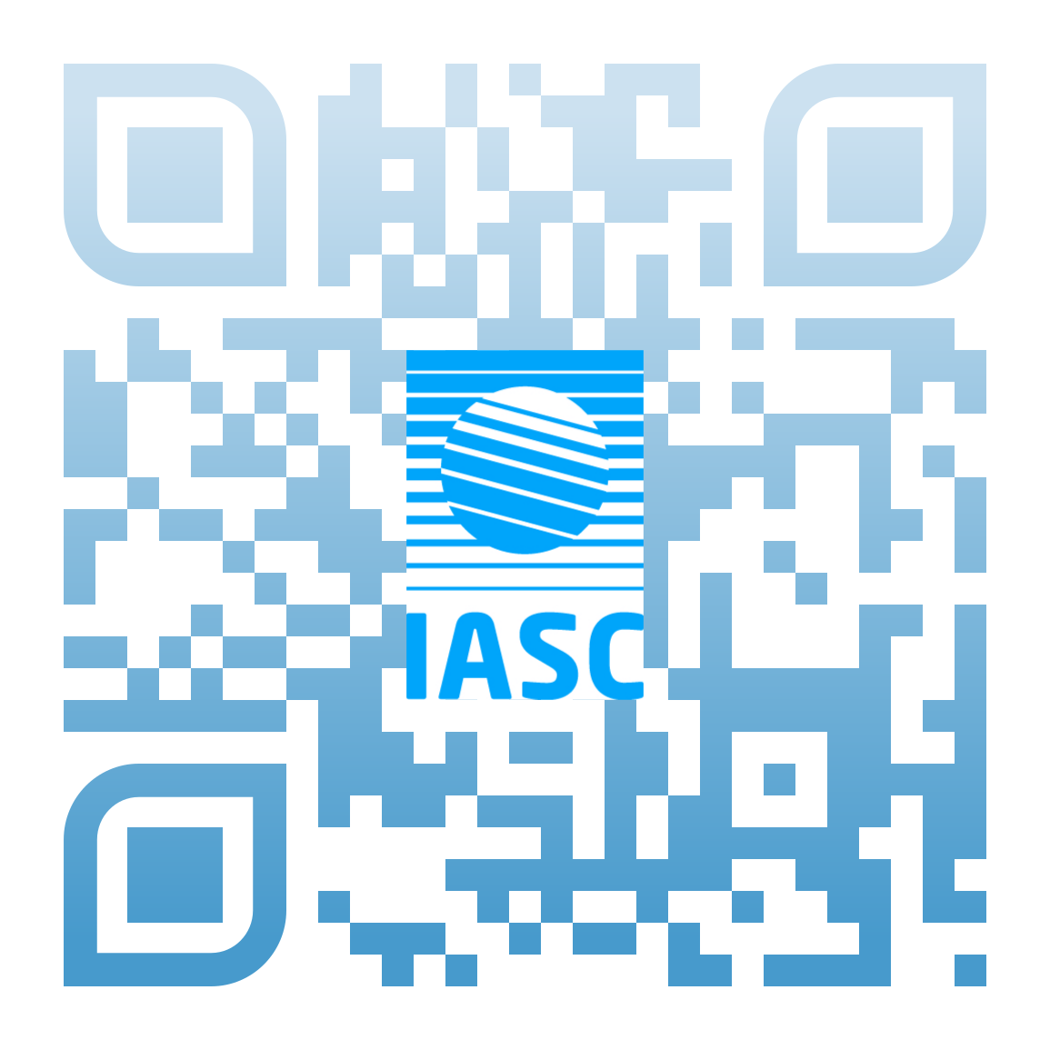
Contact us!
Photo: Gerlis Fugmann
www.iasc.info
www.icarp.iasc.info
info@iasc.info
... or visit us in the IASC Secretariat in Akureyri, Iceland!
Notes:
Thank you very much for your attention.

